Slide 1

Explaining Anatomical Shape Variability Johannes Kiechle – 16.11.2022

Slide 2
Raw Data
Preprocessing
Shape Analysis
linear
non-linear
ShapeWorks
Variational Graph AE
Particle Based Model
Mesh Registration
(Supervised) PCA
Supervised Disentangling
Latent
Reconstruction
Latent
Reconstruction
Evaluation

Slide 3
Raw Data
Preprocessing
Shape Analysis
linear
non-linear
ShapeWorks
Variational Graph AE
Particle Based Model
Mesh Registration
(Supervised) PCA
Supervised Disentangling
Latent
Reconstruction
Latent
Reconstruction
Evaluation

Slide 4

Raw Data
Binary hippocampus segmentations¹
1 mm isotropic voxel size
[1]: Hippocampus segmentation on high resolution diffusion MRI (Efird et al.)
20 mm
216 mm
220 mm

Slide 5
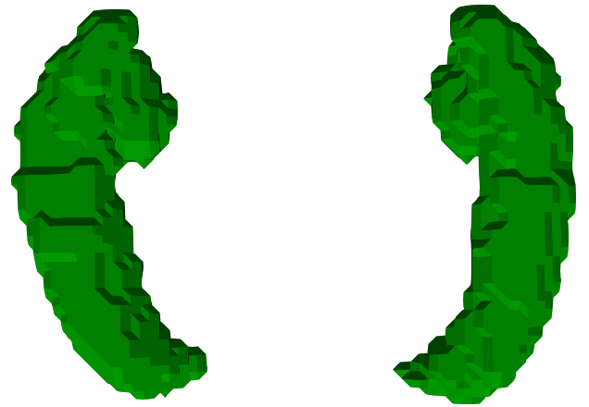
Raw Data
[1]: Marching cubes: A high resolution 3d surface construction algorithm (Lorensen et al.)
Marching Cubes¹

Slide 6
Raw Data
[1]: Marching cubes: A high resolution 3d surface construction algorithm (Lorensen et al.)
Preprocessing!
Marching Cubes¹

Slide 7
Raw Data
Preprocessing
Shape Analysis
linear
non-linear
ShapeWorks
Variational Graph AE
Particle Based Model
Mesh Registration
(Supervised) PCA
Supervised Disentangling
Latent
Reconstruction
Latent
Reconstruction
Evaluation

Slide 8
Preprocessing
Image Level
Padding
Distance Transform
Gaussian Blur
Image to Mesh
Marching Cubes
Mesh Level
Surface Smoothing
Procrustes Superimposion

Slide 9
Preprocessing
Image Level
Padding
Distance Transform
Gaussian Blur
Image to Mesh
Marching Cubes
Mesh Level
Surface Smoothing
Procrustes Superimposion

Slide 10
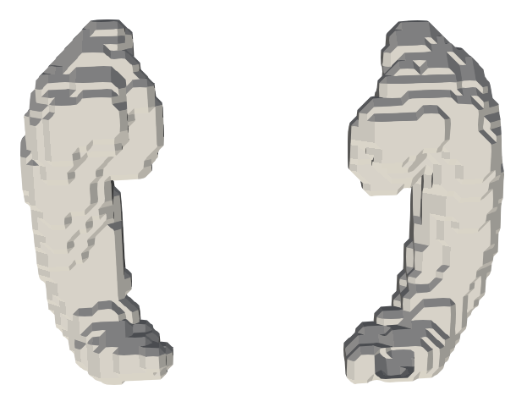
Preprocessing
Padding

Slide 11
Preprocessing
Distance transform:
A distance transformation converts a binary digital image, consisting of feature and non-feature pixels, into an image where all non-feature pixels have a value corresponding to the distance to the nearest feature pixel
Gaussian blur:
Gaussian blur feature is obtained by blurring (smoothing) an image using a Gaussian function to reduce the noise level
Nonuniform low-pass filter that preserves low spatial frequency and reduces image noise and negligible details in an image
Small Gaussian kernel is applied in order to preserve mesh topology

Slide 12
Preprocessing
Image Level
Padding
Distance Transform
Gaussian Blur
Image to Mesh
Marching Cubes
Mesh Level
Surface Smoothing
Procrustes Superimposion

Slide 13
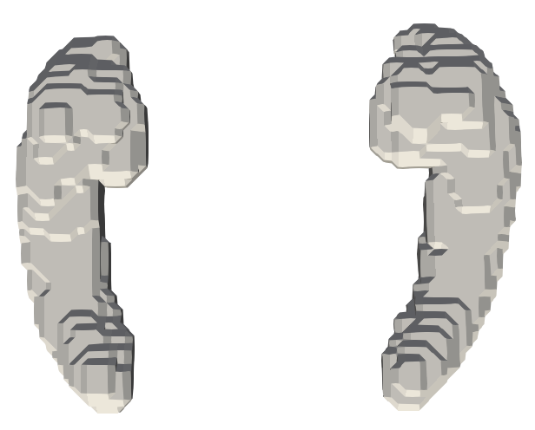
Preprocessing
Image to Mesh: Without sharp edges and surface spikes, but still „blocky“.

Slide 14
Preprocessing
Image Level
Padding
Distance Transform
Gaussian Blur
Image to Mesh
Marching Cubes
Mesh Level
Surface Smoothing
Procrustes Superimposion

Slide 15
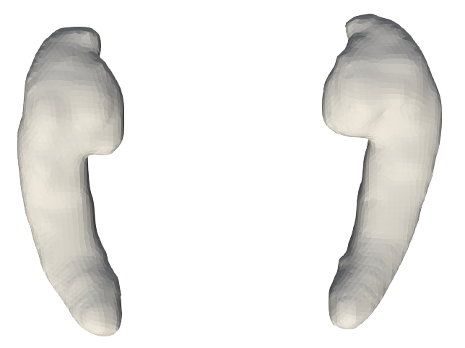
Preprocessing
Laplacian surface smoothing
after
before

Slide 16
Preprocessing – Procrustes Superimposition
“The shape of an object is the geometric information that remains after removal of positional, rotational, and scaling effects¹.”
[1]: Statistical Shape Analysis (Dryden et al.)
1. Translation
2. Scaling
3. Rotation

Slide 17
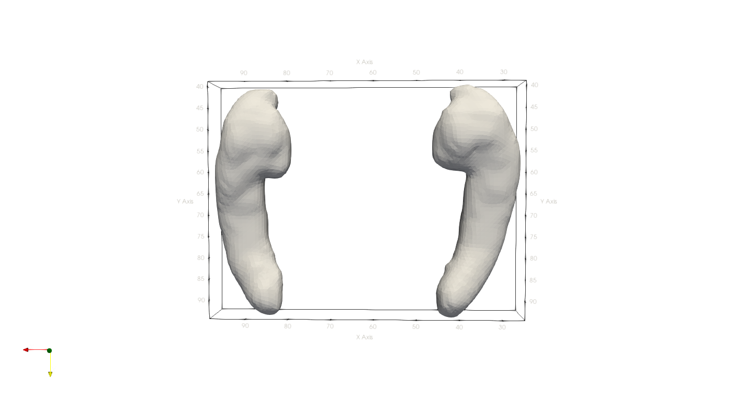

Preprocessing – Procrustes Superimposition
“The shape of an object is the geometric information that remains after removal of positional, rotational, and scaling effects¹.”
Procrustes superimposition: Translation
[1]: Statistical Shape Analysis (Dryden et al.)
after
before

Slide 18

Preprocessing – Procrustes Superimposition
“The shape of an object is the geometric information that remains after removal of positional, rotational, and scaling effects¹.”
Procrustes superimposition: Scaling
[1]: Statistical Shape Analysis (Dryden et al.)
after
before

Slide 19
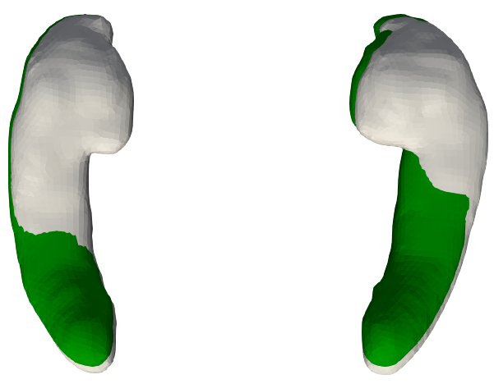
Preprocessing – Procrustes Superimposition
“The shape of an object is the geometric information that remains after removal of positional, rotational, and scaling effects¹.”
Procrustes superimposition: Rotation
[1]: Statistical Shape Analysis (Dryden et al.)
after rotation
before rotation

Slide 20
Raw Data
Preprocessing
Shape Analysis
linear
non-linear
ShapeWorks
Variational Graph AE
Particle Based Model
Mesh Registration
(Supervised) PCA
Supervised Disentangling
Latent
Reconstruction
Latent
Reconstruction
Evaluation

Slide 21
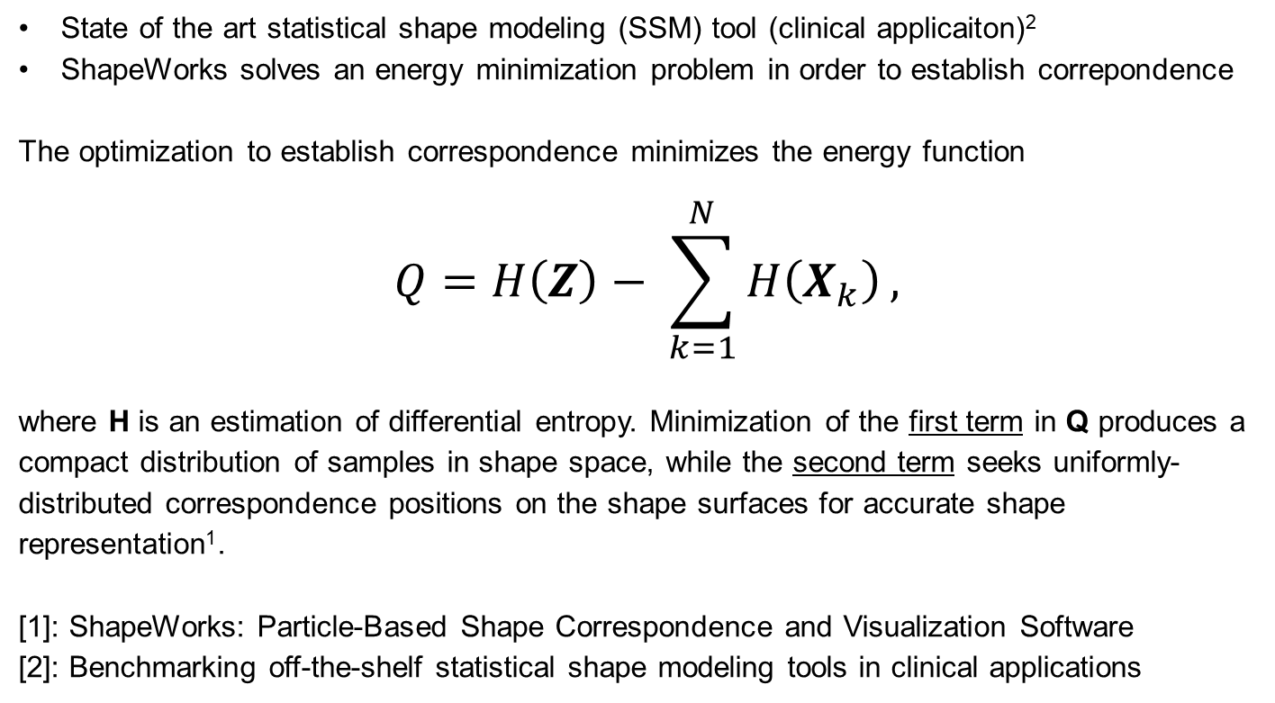
Shape Analysis – ShapeWorks¹
State of the art statistical shape modeling (SSM) tool (clinical application)²
ShapeWorks solves an energy minimization problem in order to establish correspondence
The optimization to establish correspondence minimizes the energy function
$$Q=H\left(Z\right)− \sum_{k=1}^{N}{H\left(X_{k}\right)},$$
where H is an estimation of differential entropy. Minimization of the first term in Q produces a compact distribution of samples in shape space, while the second term seeks uniformly-distributed correspondence positions on the shape surfaces for accurate shape representation¹.
[1]: ShapeWorks: Particle-Based Shape Correspondence and Visualization Software
[2]: Benchmarking off-the-shelf statistical shape modeling tools in clinical applications

Slide 22
Raw Data
Preprocessing
Shape Analysis
linear
non-linear
ShapeWorks
Variational Graph AE
Particle Based Model
Mesh Registration
(Supervised) PCA
Supervised Disentangling
Latent
Reconstruction
Latent
Reconstruction
Evaluation

Slide 23
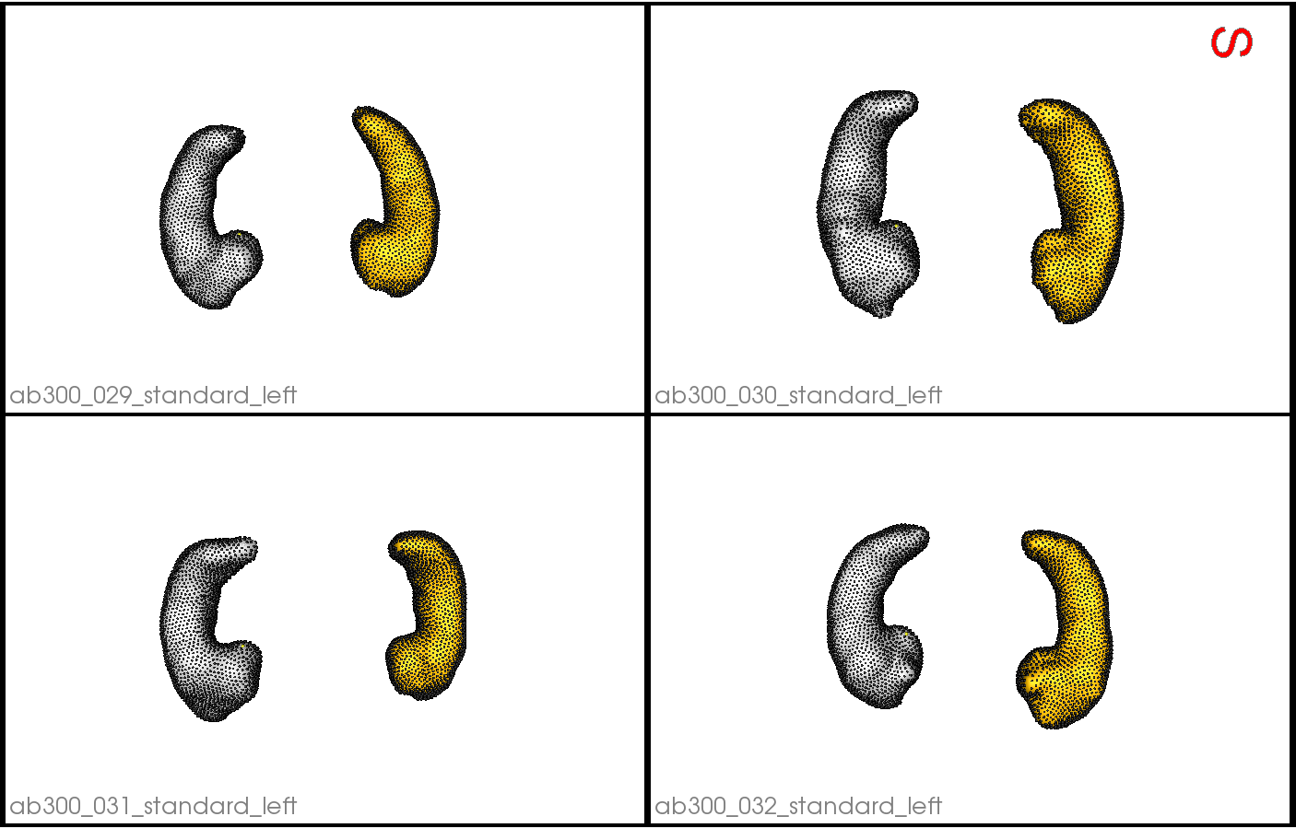
Shape Analysis – Particle Based Model

Slide 24
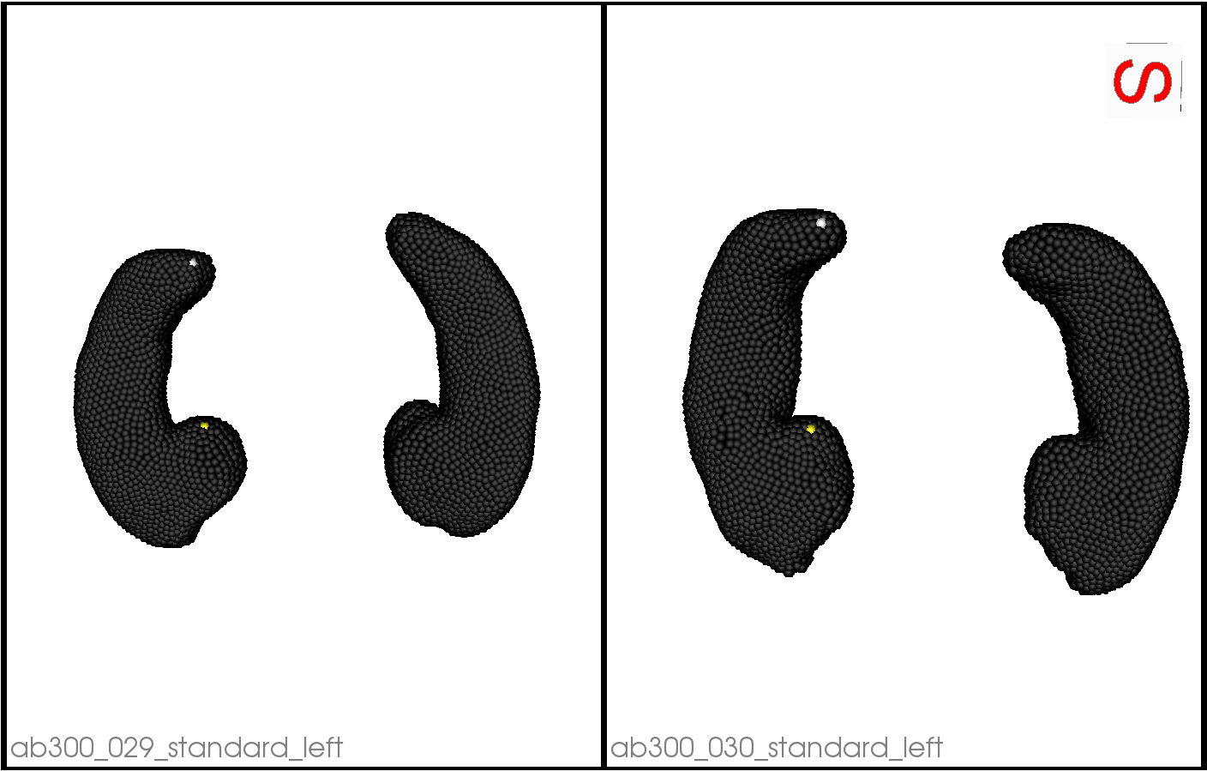
Shape Analysis – Particle Based Model (cont‘d)

Slide 25
Shape Analysis – Particle Based Model (cont‘d)
Open Question:
How to evaluate correpondence besides visual inspection?

Slide 26
Raw Data
Preprocessing
Shape Analysis
linear
non-linear
ShapeWorks
Variational Graph AE
Particle Based Model
Mesh Registration
(Supervised) PCA
Supervised Disentangling
Latent
Reconstruction
Latent
Reconstruction
Evaluation

Slide 27
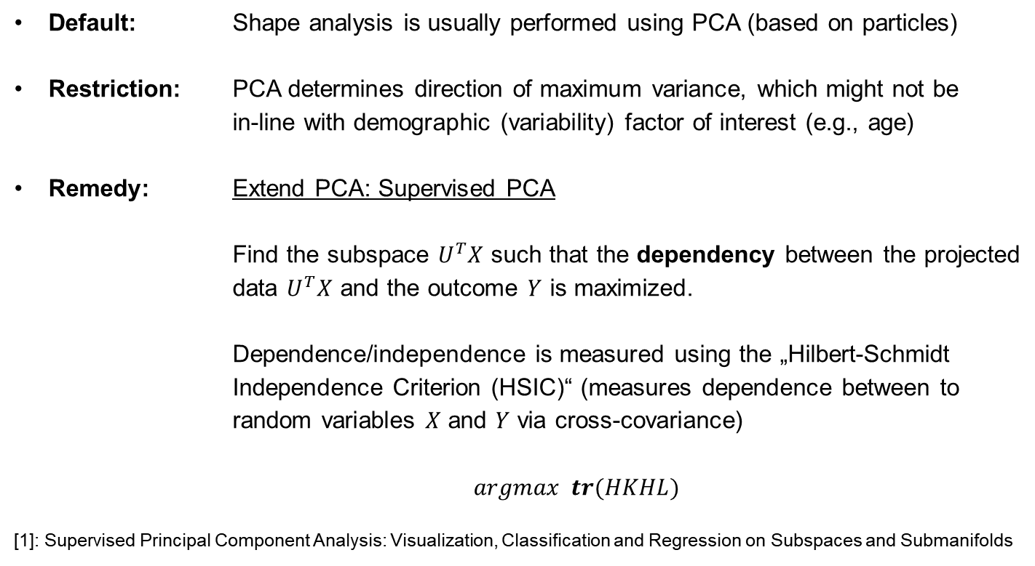
Shape Analysis – (Supervised) PCA¹
Default: Shape analysis is usually performed using PCA (based on particles)
Restriction: PCA determines direction of maximum variance, which might not be in-line with demographic (variability) factor of interest (e.g., age)
Remedy: Extend PCA: Supervised PCA Find the subspace $U^{T}X$ such that the dependency between the projected data $U^{T}X$ and the outcome $Y$ is maximized.
Dependence/independence is measured using the „Hilbert-Schmidt Independence Criterion (HSIC)“ (measures dependence between to random variables $X$ and $Y$ via cross-covariance)
$argmax tr(HKHL)$
[1]: Supervised Principal Component Analysis: Visualization, Classification and Regression on Subspaces and Submanifolds

Slide 28
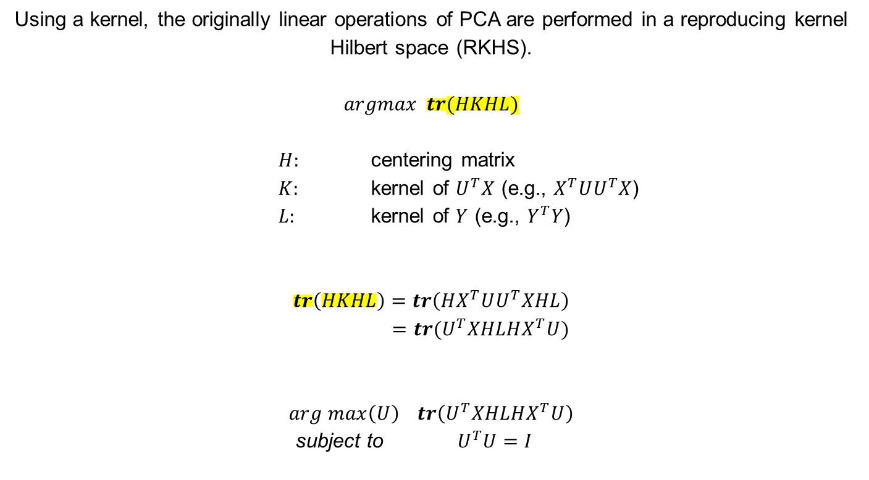
Shape Analysis – (Supervised) PCA (cont‘d)
Using a kernel, the originally linear operations of PCA are performed in a reproducing kernel Hilbert space (RKHS).
$$argmax tr(HKHL)$$
$H:$ centering matrix
$K:$ kernel of $U^{T}X$ (e.g., $X^{T}UU^{T}X$)
$L:$ kernel of $Y$ (e.g., $Y^{T}Y$)
$$tr\left(HKHL\right)=tr\left(HX^{T}UU^{T}XHL\right) \\ =tr(U^{T}XHLHX^{T}U)$$
$$arg max\left(U\right) tr\left(U^{T}XHLHX^{T}U\right)$$
subject to ${ U}^{T}U=I$

Slide 29
Raw Data
Preprocessing
Shape Analysis
linear
non-linear
ShapeWorks
Variational Graph AE
Particle Based Model
Mesh Registration
(Supervised) PCA
Supervised Disentangling
Latent
Reconstruction
Latent
Reconstruction
Evaluation

Slide 30
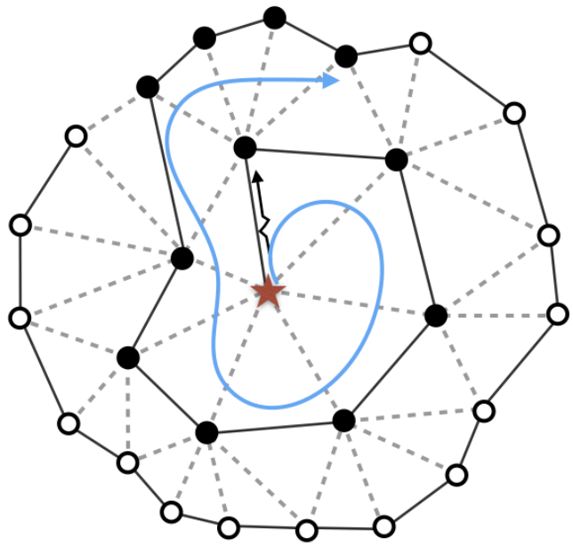





Shape Analysis - Variational Graph AE
Building blocks:
1. Variational autoencoder:
„Auto-Encoding Variational Bayes (Kingma et al.)“
2. Graph convolution:
„SpiralNet++: A Fast and Highly Efficient Mesh Convolution Operator (Ding et al.)”
μ
$$x$$
$$f_{φ}(x)$$
$${ g}_{θ}(z)$$
$$\hat{x}$$
σ
$$z$$

Slide 31
Raw Data
Preprocessing
Shape Analysis
linear
non-linear
ShapeWorks
Variational Graph AE
Particle Based Model
Mesh Registration
(Supervised) PCA
Supervised Disentangling
Latent
Reconstruction
Latent
Reconstruction
Evaluation

Slide 32
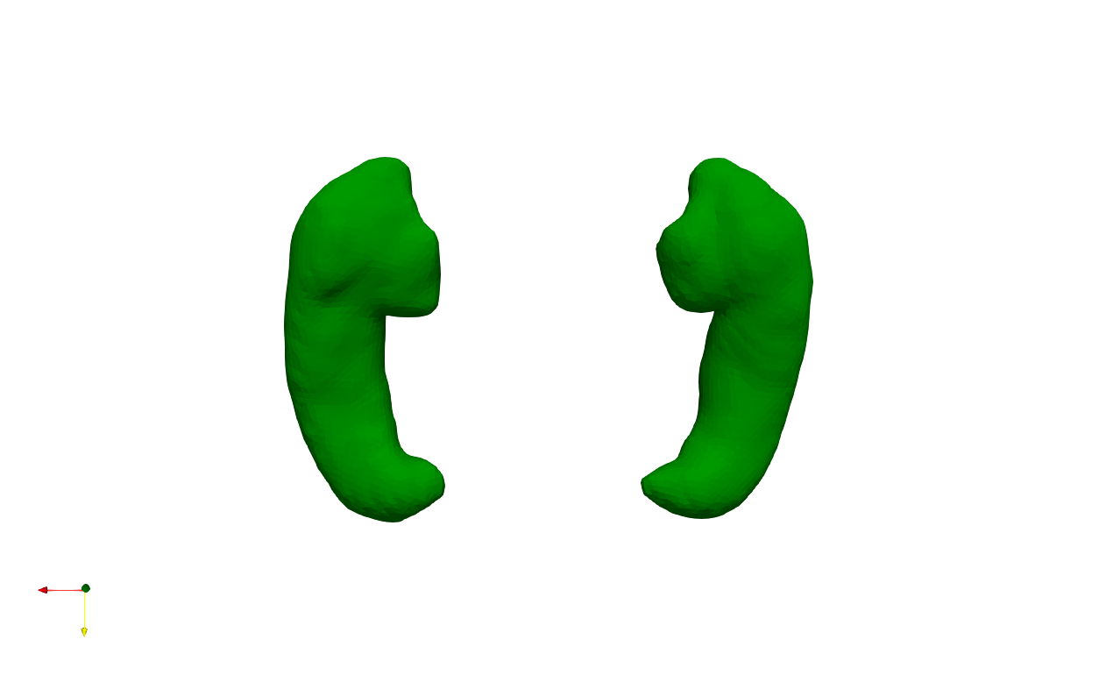
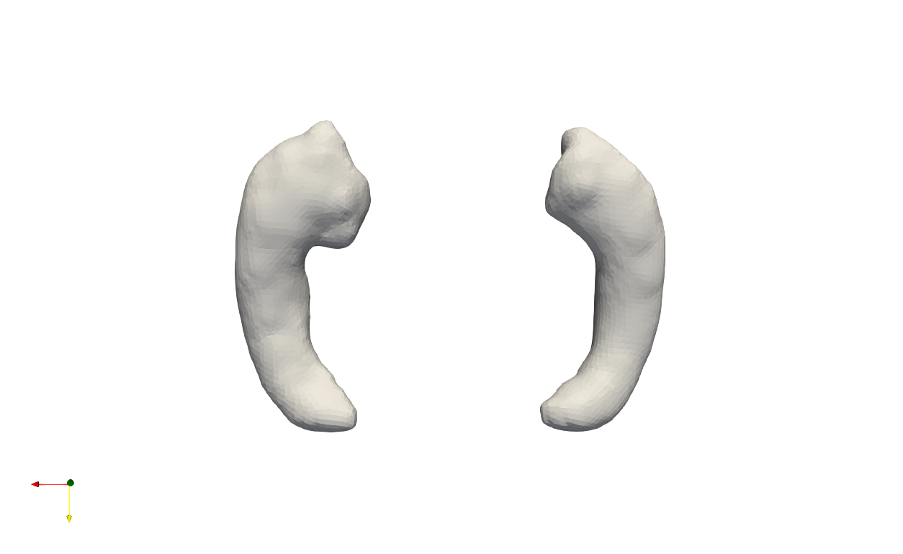
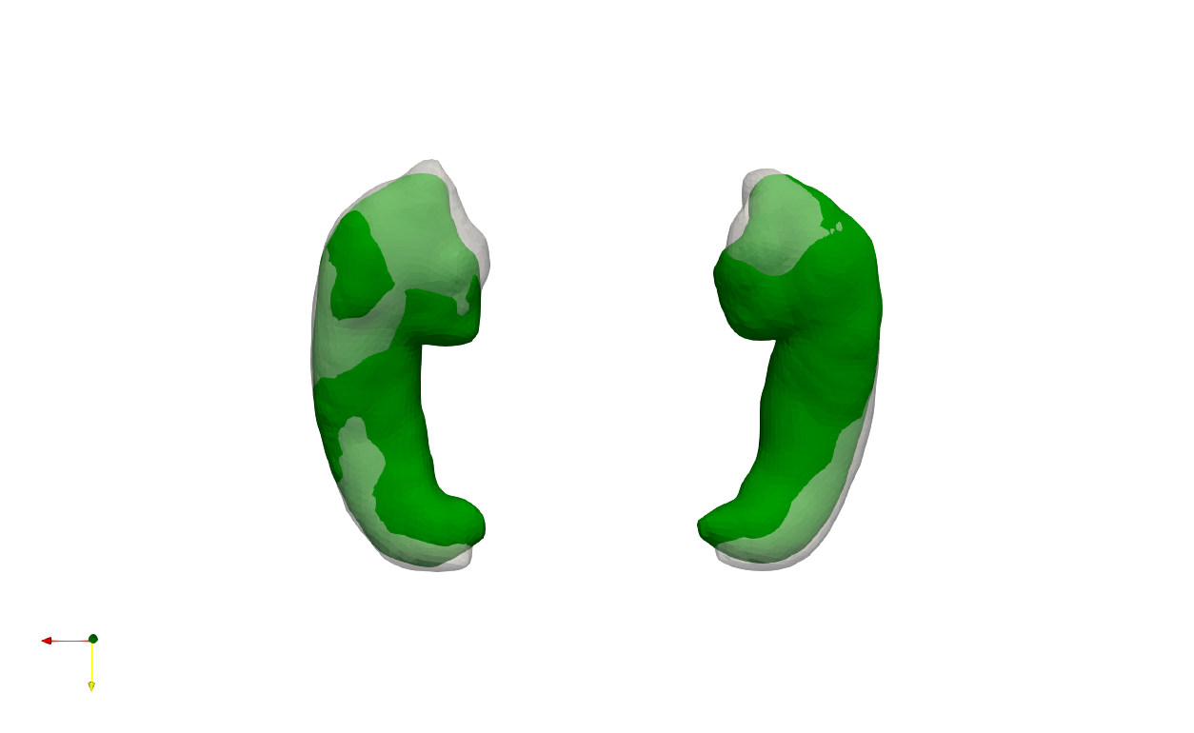
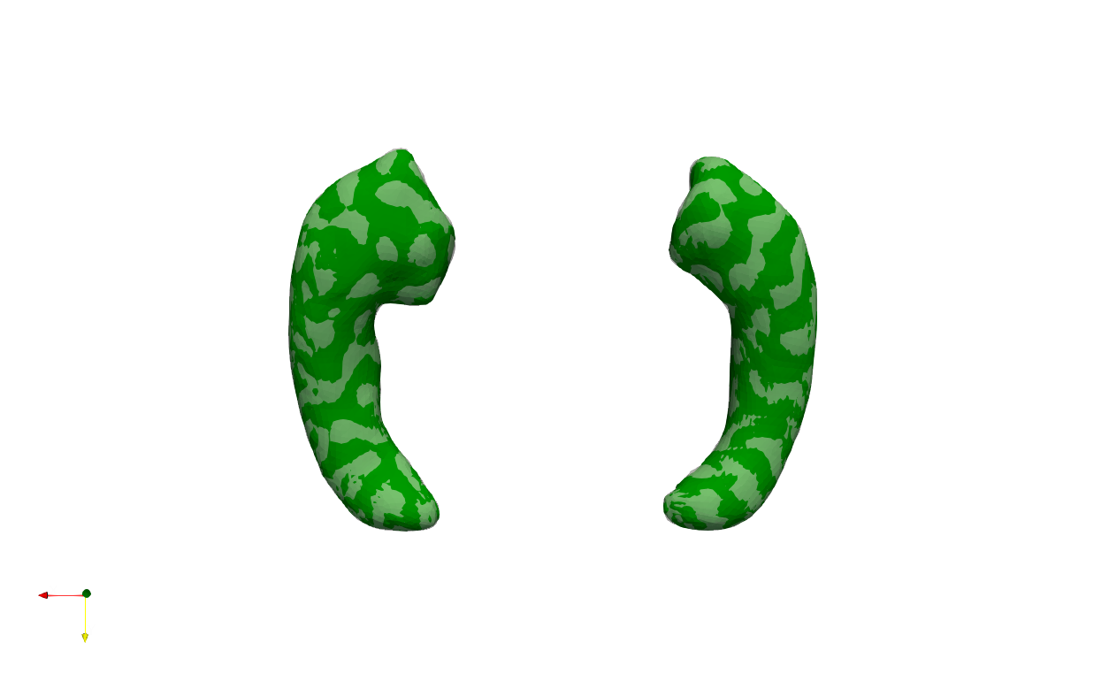
Shape Analysis – Mesh Registration
Source
(Template)
Initial
alignment
Target
Registration
An example of non-rigid registration, where the source 3D mesh is deformed in a non-rigid manner to align with the target mesh (original).

Slide 33
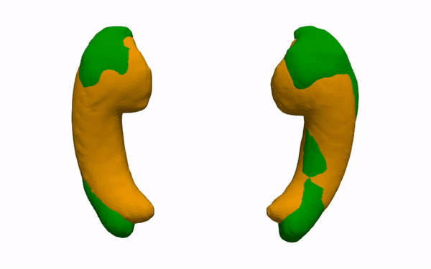
Shape Analysis – Mesh Registration (cont‘d)
original
reconstruction
An example of non-rigid registration, where the source 3D mesh is deformed in a non-rigid manner to align with the target mesh (original).

Slide 34
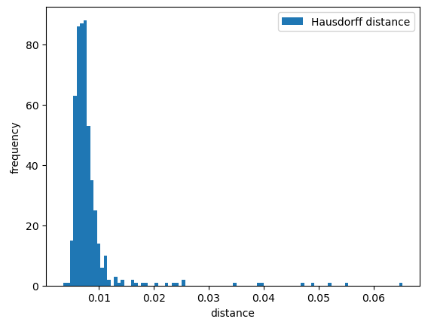
Shape Analysis – Mesh Registration (cont‘d)
mean | 0.008291 mm
std | 0.005706 mm
min | 0.003470 mm
max | 0.065281mm
25% | 0.006288 mm
50% | 0.007197 mm
75% | 0.008268 mm

Slide 35
Raw Data
Preprocessing
Shape Analysis
linear
non-linear
ShapeWorks
Variational Graph AE
Particle Based Model
Mesh Registration
(Supervised) PCA
Supervised Disentangling
Latent
Reconstruction
Latent
Reconstruction
Evaluation

Slide 36

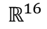


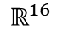
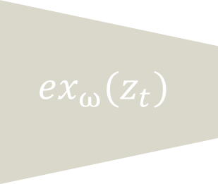

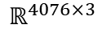

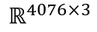
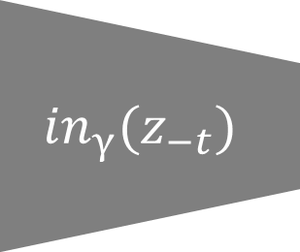


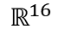
Shape Analysis – Supervised Disentangling¹
${ex}_{ω}(z_{t})$
$$\hat{y}$$
μ
$$x$$
$$f_{φ}(x)$$
$$ℝ^{16}$$
$$g_{θ}(z)$$
$$\hat{x}$$
$$ℝ^{4076×3}$$
σ
$$ℝ^{4076×3}$$
$$ℝ^{16}$$
${in}_{γ}(z_{−t})$
$$z$$
$$ℝ^{16}$$
$$\hat{y}$$
[1] Guided Variational Autoencoder for Disentanglement Learning

Slide 37
Raw Data
Preprocessing
Shape Analysis
linear
non-linear
ShapeWorks
Variational Graph AE
Particle Based Model
Mesh Registration
(Supervised) PCA
Supervised Disentangling
Latent
Reconstruction
Latent
Reconstruction
Evaluation

Slide 38
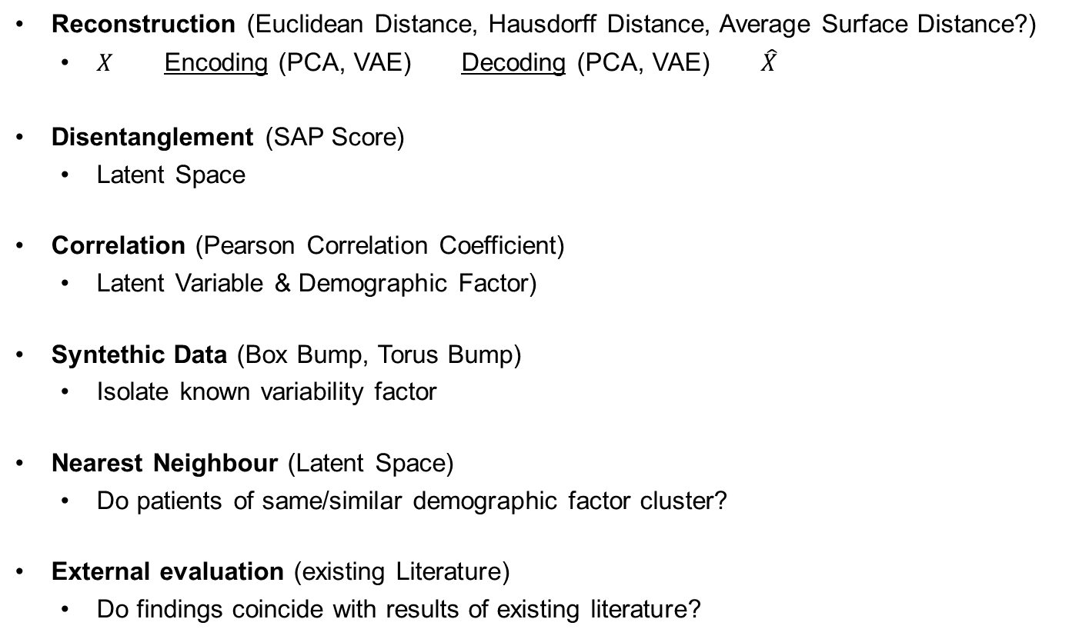
Evaluation
Reconstruction (Euclidean Distance, Hausdorff Distance, Average Surface Distance?)
$X$ Encoding (PCA, VAE) Decoding (PCA, VAE) $\hat{X}$
Disentanglement (SAP Score)
Latent Space
Correlation (Pearson Correlation Coefficient)
Latent Variable & Demographic Factor)
Synthetic Data (Box Bump, Torus Bump)
Isolate known variability factor
Nearest Neighbor (Latent Space)
Do patients of same/similar demographic factor cluster?
External evaluation (existing Literature)
Do findings coincide with results of existing literature?

Slide 39
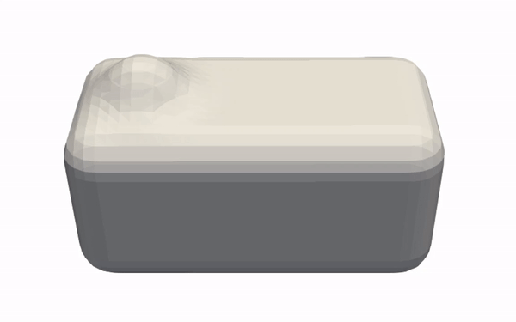
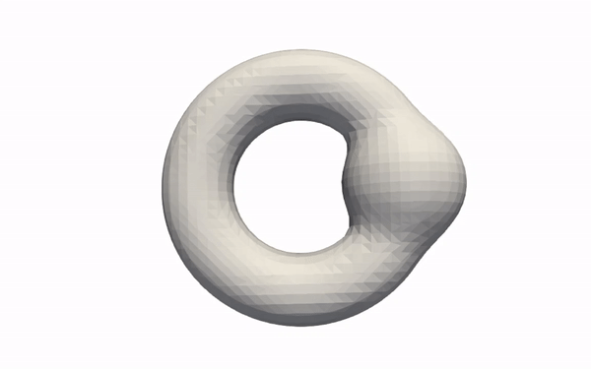
Evaluation – Synthetic Data
Box-Bump
Torus-Bump

Slide 40
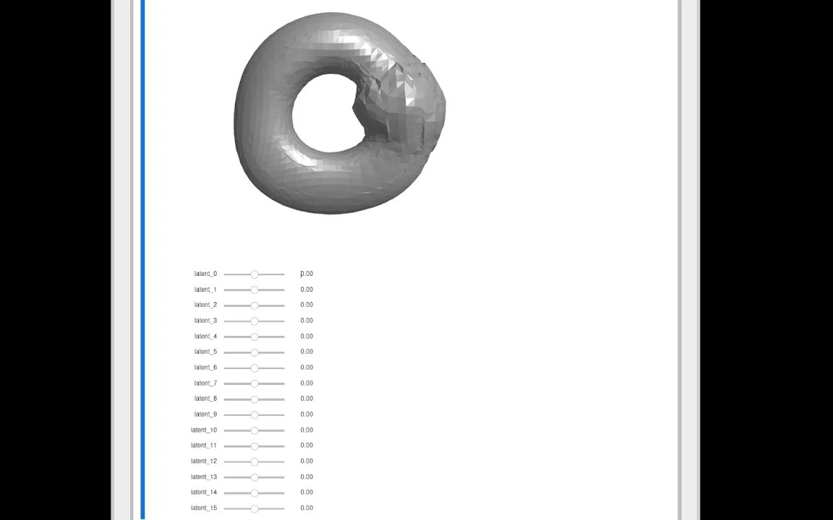
Evaluation

